Slide 1
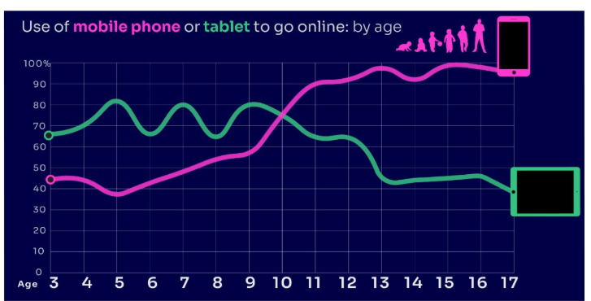
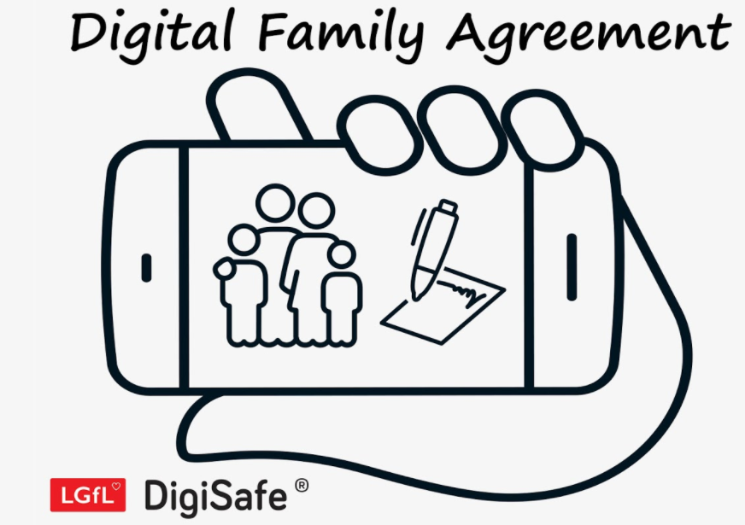
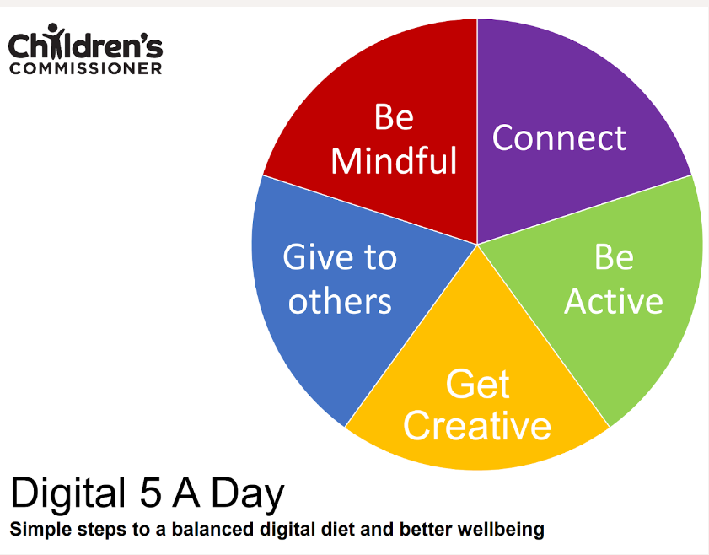
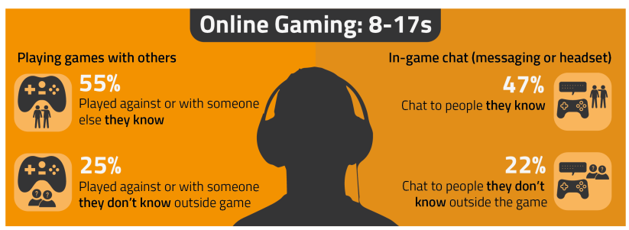
PARENT ONLINE SAFETY
Notes:
This presentation brings together:
- the latest research and key findings on children’s and young people’s online use and risk
- parents’ views about their children’s media use, devices and supervision to monitor or limit use
- suggested resources and tips to empower parents to keep up with the latest trends/apps and games, manage controls and settings, and talk to children about risk - from bullying and sharing content, to extremism and gangs

Slide 2
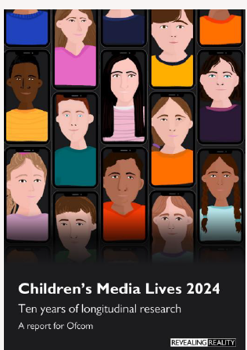
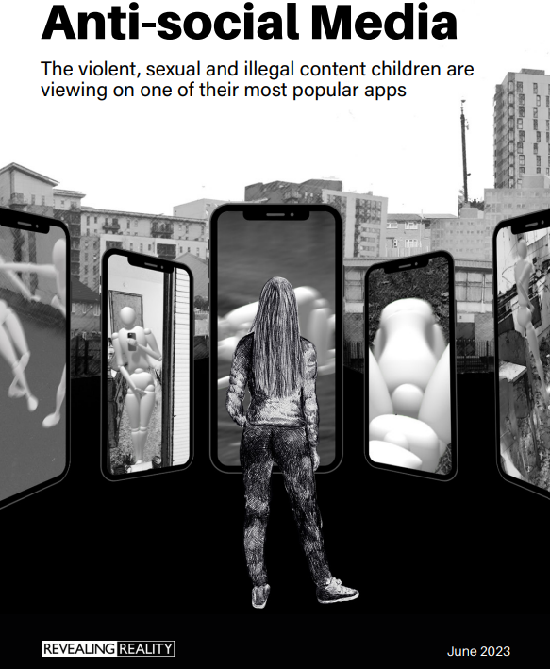
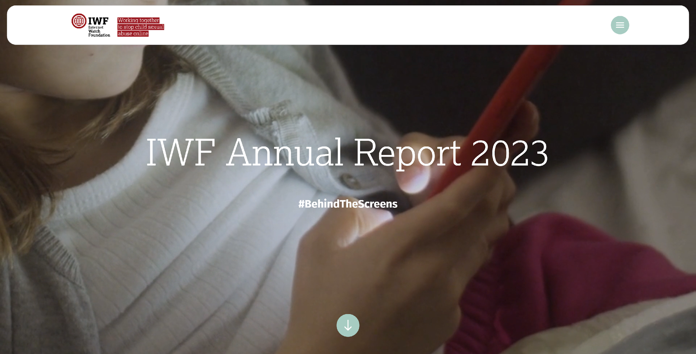
This presentation brings together:
Key Findings from:
Children and parents: Media Use and Attitudes report
Children’s Online User Ages 2023 Quantitative Research Study
Children’s Media Lives: Year 10 findings – 19 April 2024
Revealing-Reality Anti-social Media Report 2023
Internet Watch Foundation Annual Report 2023
Evidence on pornography’s influence on harmful sexual behaviour among children Report 2023
Suggested Resources and Tips for Staff to help Parents/Carers:
keep up with the latest trends, apps and games
manage controls and settings
talk to children about risk

Slide 3
Warning!
Notes:
Some of the content from this presentation may be sensitive or upsetting for parents/carers. You may wish to use/adapt this slide as a trigger warning, depending on the topic(s) you cover, e.g. online sexual abuse.

Slide 4
TALKING TO YOUR CHILD ABOUT LIFE ONLINE

Slide 5
What are you most WORRIED about when your child is ONLINE?
Notes:
ASK: Find out what parents are currently worried about
TELL: Despite the positive finding that over seven in ten (72%) 8-17-year-olds who use messaging/social media sites or apps feel safe when using these apps/online sites, either all or most of the time, the online space is a risky environment for children.

Slide 6
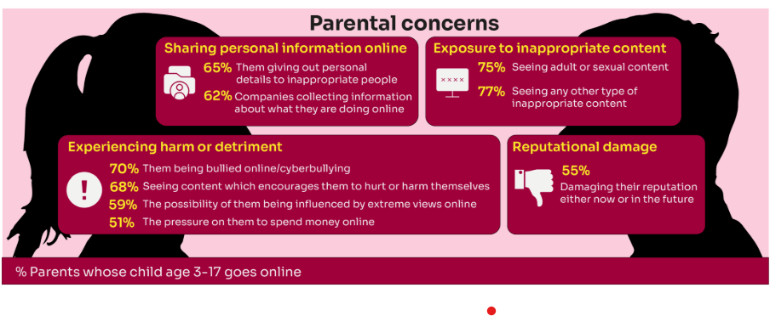
Summary of parental concerns (3 – 17 yr-olds)
Source: Children and parents: media use and attitudes report 2024
Notes:
Many parents indicate that they have concerns around various aspects of their children’s online activities.
The primary concern among parents of 3-17s is that their child will be exposed to inappropriate content for their age group (77% of parents were either very or fairly concerned about this aspect of their child’s online use) or see adult/sexual content (75% of parents).
Another common concern among these parents is that their child will experience some sort of harm or detriment while online; for example, seven in ten parents are concerned that their child will be bullied online (70%) or will see content which encourages them to hurt or harm themselves (68%).
Three in five (59%) parents are concerned that there is a possibility of their child being influenced by extreme views online.
Half (51%) worry about the pressure on their child to spend money online.
More than three in five parents are also concerned about their children giving away their personal data. Sixty-five percent are worried about the personal details the child themself may give out to inappropriate people, as well as 62% of parents who worry about companies collecting information about what their child is doing online.
Finally, over half (55%) of parents said they were concerned about their child’s online use and how it might damage their reputation, either now or in the future.

Slide 7
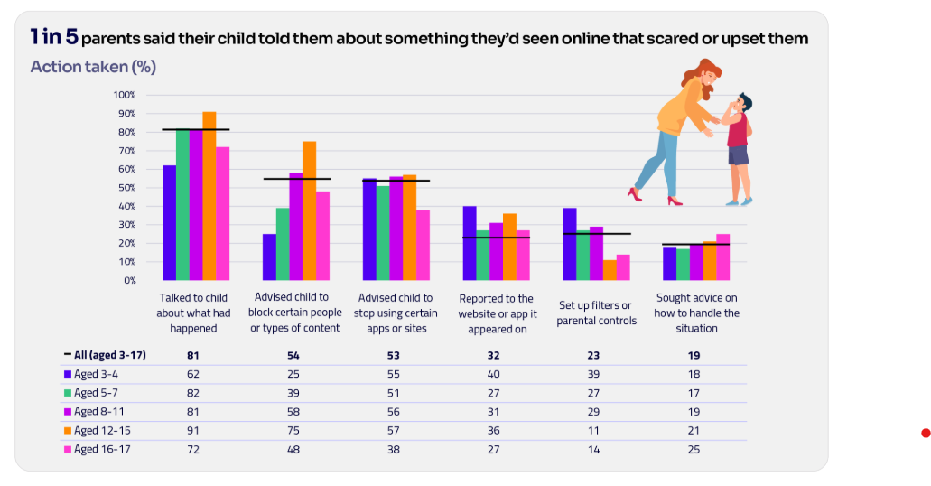
Are you CONFIDENT to TALK TO YOUR CHILD?
Is your child confident to TALK TO YOU?
WHAT WOULD YOU DO?
Are there any areas you would not feel confident or comfortable to discuss?
Younger children are more likely to tell someone if they see something worrying or nasty online:
Two-thirds of 8-11-year-olds say that they would always tell someone (66%)
Almost half of 12-15s and 16- 17s (49% and 45% respectively).
Source: Children and parents: media use and attitudes report 2024
Notes:
Four in five parents (81%) chose to talk to their child about what had happened.
Just over half advised their child to block a specific type of content or person (54%) or who recommended that their child stop using certain apps or sites (53%).
However, only a third of parents in this situation (32%) suggested reporting the content to the site or app on which it appeared.
TELL:
You do not need to be an IT expert to help your child stay safe online. One of the best things you can do to protect your children is to talk regularly with them about their use of technology- just as you do with all other areas of parenting.
Having an open and honest approach is best - reacting, without involving them or talking to them, can often push behaviour underground, so it still happens, but you are less likely to know about it. This can increase risk to your child.

Slide 8
YOU don’t need to be an EXPERT … be a PARENT
It’s your choice - Don’t let others dictate when the right time is to use tech.
Stay involved – make time to communicate, talk about what they are doing. What do they enjoy? What makes them laugh?
Don’t quiz them – have regular conversations. What's their favourite app? What is the best site to learn new things from?
Join in - watch them play a game and join in. Who are they playing with? Do they know the other players?
‘Show me how…’ – ask their advice to help you with your privacy settings, who you should add as a friend, are there any risks?
Lead by example - children learn as much from watching as they do from being told not to do something, so model good behaviour
Reassure them - tell them that they won't get in trouble and that you are always there to help.
Notes:
ASK – What do you do that works well? Share good practice
REMIND - You do not need to be a tech expert to help your child with staying safe online. It’s ultimately about communication and being proactive.

Slide 9
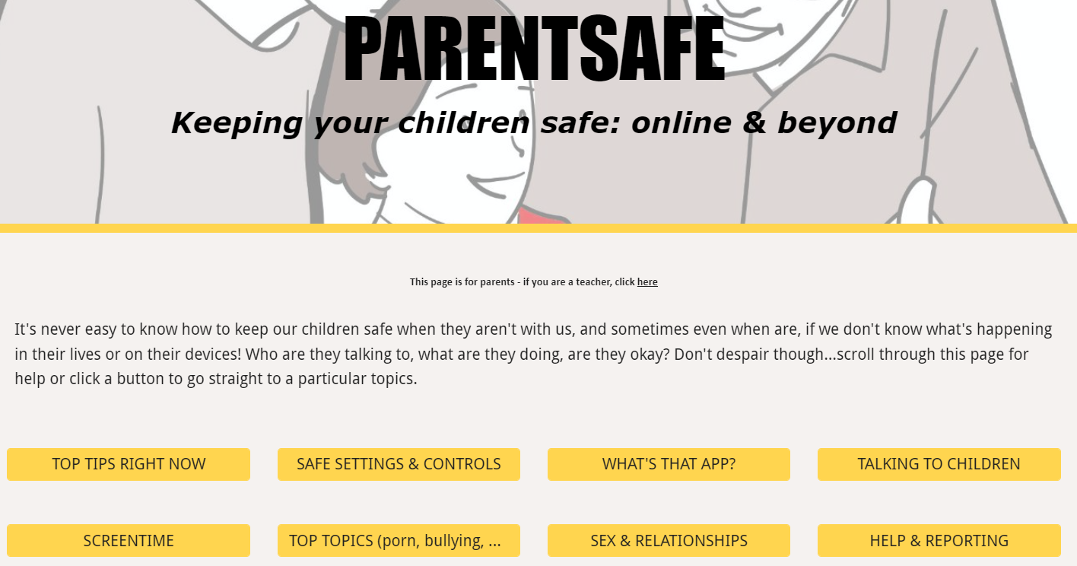
parentsafe.lgfl.net
Notes:
TELL - It's never easy to know how to keep our children safe, especially if we don't know what's happening in their lives or on their devices! Who are they talking to, what are they doing, are they okay? Don't despair though... We’ve created a dedicated website for parents and carers - simply scroll through ParentSafe for help or click a button to go straight to a particular topics. We will look at some of these resources and tips shortly

Slide 10
SHARING NUDES AND SEMI-NUDES

Slide 11
Research by Revealing Reality in 2022 of 15 – 18 year olds found
20% of girls have sent a nude picture or
video of themselves
60% of girls and 31% of boys have been asked to share a nude or semi-nude photo or video
54% of girls and 30% of boys had experienced non consensual nude or semi-nude sharing

Slide 12
Nudes / Semi-Nudes
Older girls (aged 16-18) were more likely than boys to have ever been exposed to potentially uncomfortable or unwanted types of contact:
Asked to share naked/half-dressed pictures of themselves 24% (2023) vs 9% (2022)
Receiving pictures or videos of naked / half-dressed people
32% (2023) vs 11% (2022)
Source: Children and parents: Media use and attitudes report 2023
Notes:
The Online communication among children quantitative research study found that older girls (aged 16-18) were more likely than boys of the same age to have ever been exposed to all ten of the potentially uncomfortable or unwanted types of contact about which they were asked. These include receiving pictures or videos of naked/half-dressed people (32% vs 11%) and being asked to share naked/half-dressed pictures of themselves (24% vs 9%).

Slide 13
Impact of non-consensual sharing can include
FEAR, DISTRESS, HELPLESSNESS
SELF-BLAME
SHAME
HIGHER LEVELS OF DEPRESSION AND ANXIETY
REPUTATIONAL DAMAGE
‘CANCELLATION’
VICTIM
BLAMING
REVICTIMISATION
THROUGH SHARING

Slide 14
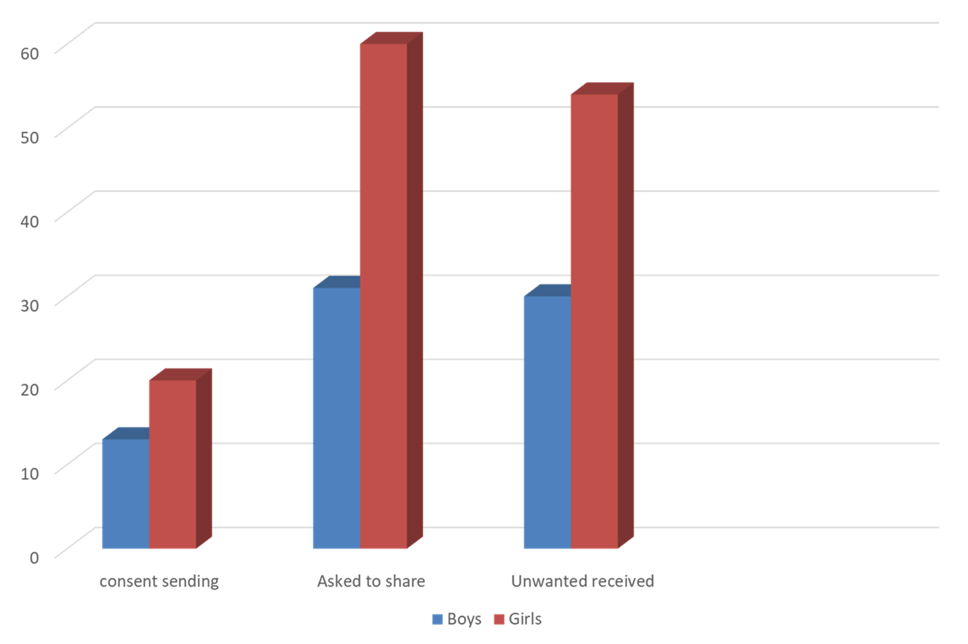
12-15 YRS OLS

Slide 15
This is happening here…

Slide 16
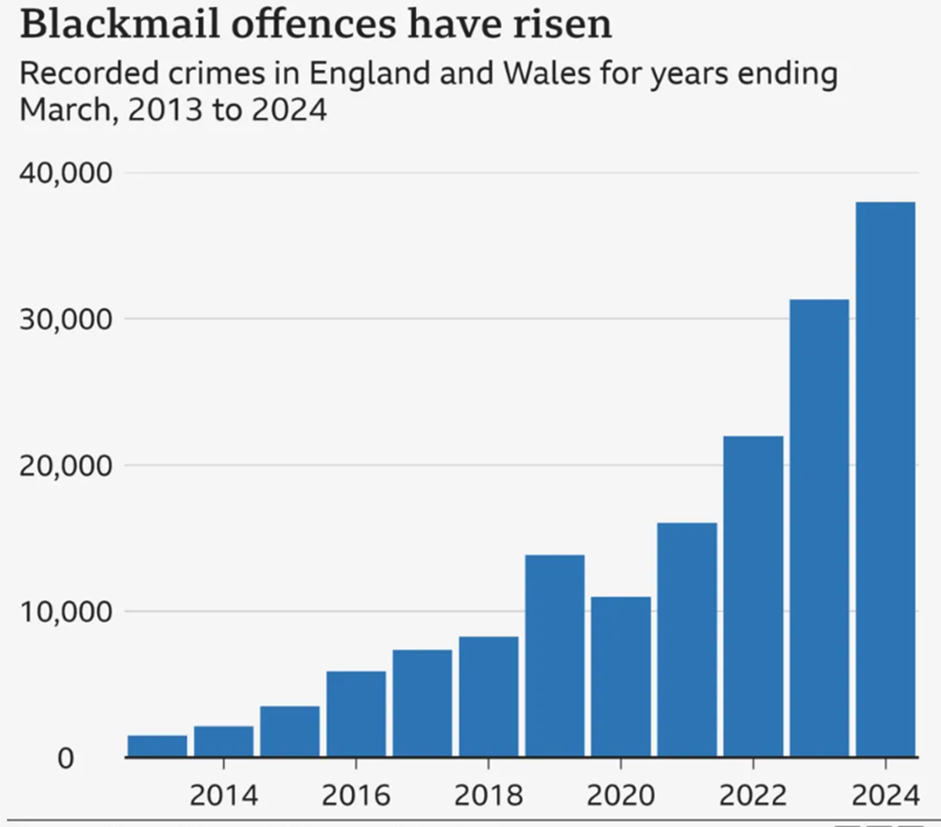

Slide 17
WHAT DO WE DO?
WHAT CAN YOU DO?

Slide 18
PSHE
SURVEYS
PEER MENTORING
SAFEGUARDING TALKS
BLOG INFORMATION ON FIREFLY
TUTOR TALKS
FILTERING AND
MONITORING
HOUSE TALKS

Slide 19
What RULES do YOU SET about being online?
Spending money online (52%)
Who you can interact with online
Information their child can share online (49%)
While parental concerns in some areas have increased considerably, their enforcement of rules appears to be diminishing, partly because of resignation about their ability to intervene in their children’s online lives.
Where and when devices can / can’t be used
Types of websites and apps they can use (41%)
Video content their children are allowed to watch online (67%)
Source: Children and parents: media use and attitudes report 2024
Notes:
ASK: What rules do you set for your children? How confident are you in implementing them?

Slide 20
Why not have a family agreement to:
clarify what is allowed...or not
establish ground rules like no phones at the table or in the bedroom at night-time
agree shared expectations to reduce arguments and keep everyone safe & healthy
Download it at parentsafe.lgfl.net/digital-family-agreement
Notes:
TELL:
To help facilitate this, LGfL have created a free digital family agreement that parents could sit down and populate with all family members to agree what is and is not allowed within their family around tech use. This includes parents! WE as parents also need to role model good behaviour.

Slide 21
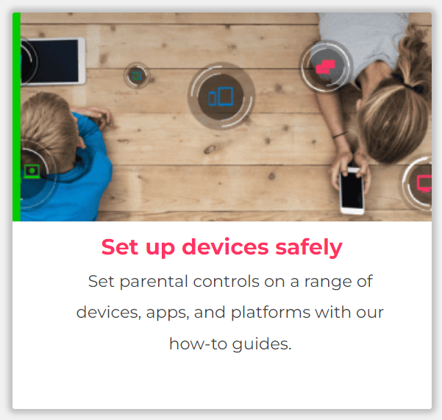
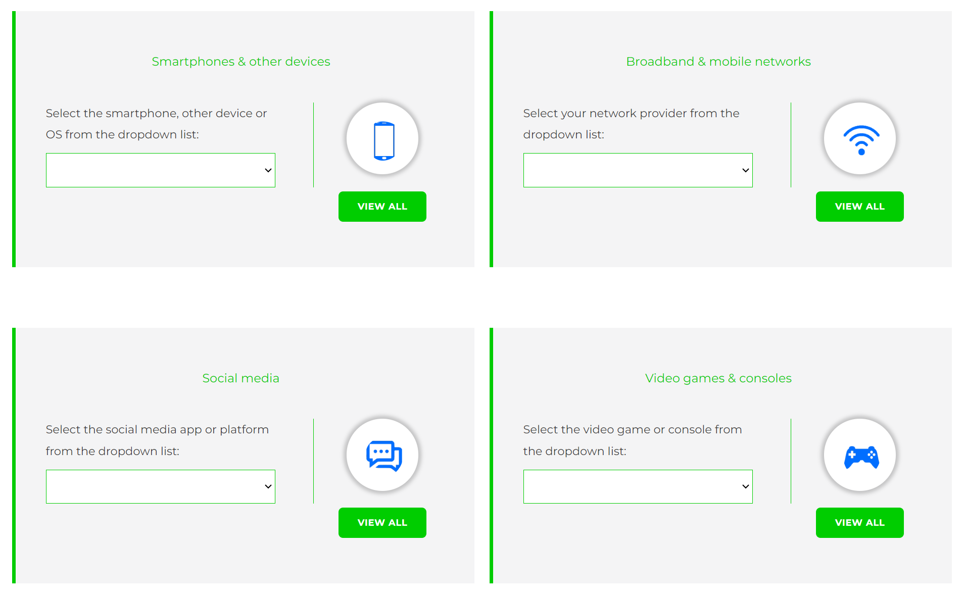
Visit www.internetmatters.org/parental-controls/ to find out how to set controls on devices:
Notes:
TELL – They can use this great page to find out how to set up controls on any smartphone, broadband, social media site/app and games console
REMIND - They need to set up parental controls on each of these individually

Slide 22
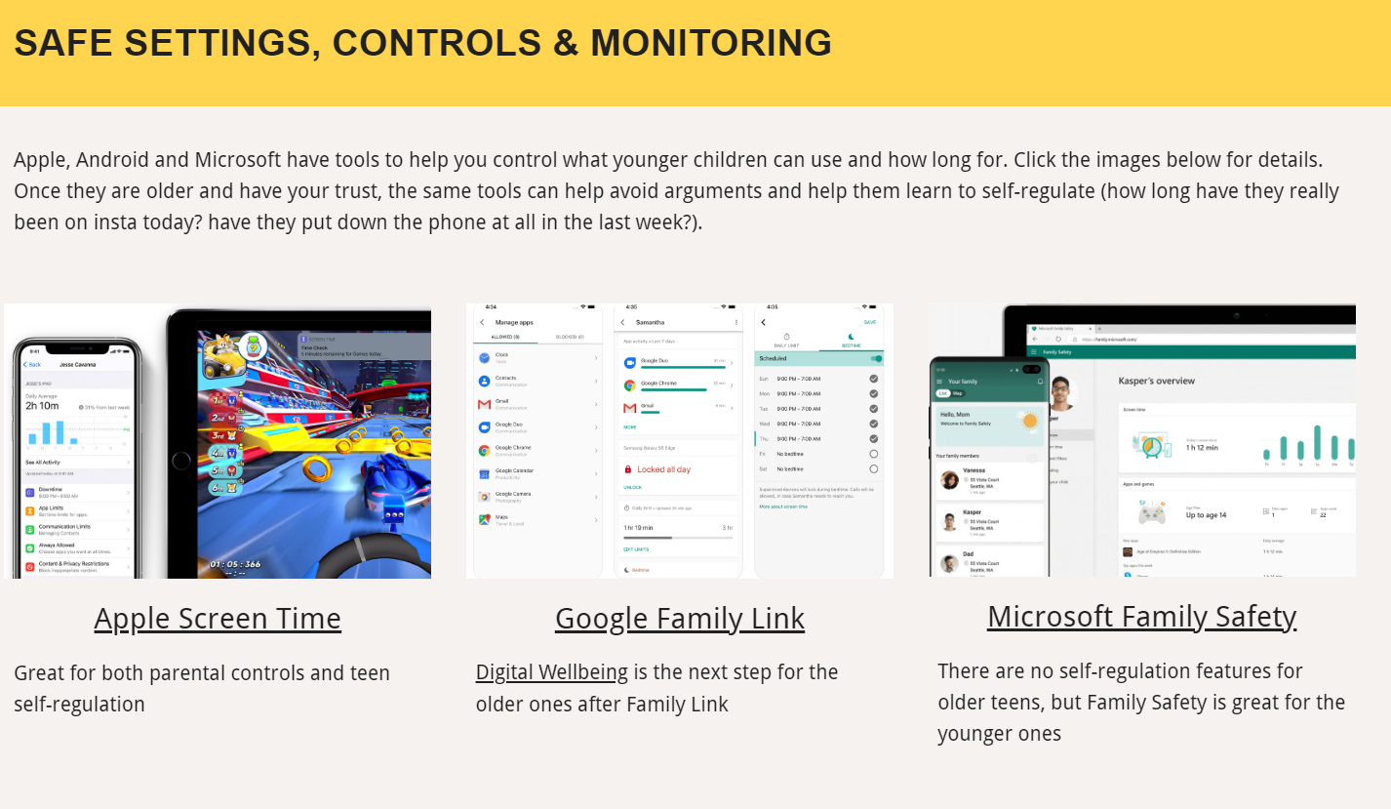
Parental control apps like Google Family Link, Screen Time and Microsoft Family can let you set limits across devices, apps and platforms
Visit parentsafe.lgfl.net/ for additional advice and tips on settings and controls for all devices
Notes:
EXPLAIN - As well as setting controls on your broadband, device, apps, games etc, Parental Control Apps like Google Family Link, Screen Time and Microsoft Family can further enhance safety by letting you set limits across devices, apps and platforms without needing to access these spaces separately. You can manage screen time, app access, inappropriate content restrictions and more.
Screen Time shows you how much time you spend on apps, websites and more. You can also set limits and restrictions for what you want to manage – on your own device or a child's device.
Family link can run on Android devices, e.g. Samsung… Parents can access and manage their child’s account and settings, and delete it if necessary
TIP – Why not run a ‘Bring your device and we’ll show you….’ pupil-led workshop to help parents with this at school?

Slide 23
What’s wrong with SHARENTING?
(when parents share photos of their children online)
Identity theft
Permanence of digital content
Losing control of images
Exposure to child predators
Creates their children’s digital footprints before they are old enough to consent to it
Notes:
TELL:
Sharenting is when parents share photos of their children online. Usually, images are shared on social media platforms to capture memorable moments in children’s lives, such as first steps, trips to the zoo, school performances, and holidays.
more than 75% of parents have shared their children’s images on social media, and 33% have never asked their children for permission before sharing photos online.
EXPLAIN THE RISKS:
Identity theft - sharenting habits expose incredible amounts of personal information about their children. More than 80% of parents use their kids’ real names on social media posts.
Permanence of digital content – even if a post is deleted, someone could have taken a copy, which could put the child at risk or lead to bullying or teasing in the future
Losing control of images - most social media sites own any content posted to their platforms. This clause is usually hidden in the terms and conditions that most users scroll through without reading. This means the platform on which it is shared has ownership of the image.
Exposure to child predators - images parents share can contain information that allows predators to track children. E.g. school or uniform, street name of the family home, while geotags can allow people with nefarious intent to track the child’s real-time location. In addition, because parents cannot control how far these photos spread, it is impossible to know where they end up, even with privacy controls in place.
Since sharenting essentially creates their children’s digital footprints before they are old enough to consent to it, the practice can also create privacy issues between children and parents that can erode trust in that relationship. For all these reasons, it is important for parents to think twice before posting about their kids.

Slide 25
THANK YOU
ANY QUESTIONS?

